Slide 1
BDPP Project Presentation
By: Abdul Rehman Basith Shajahan

Slide 2
Agenda
Introduction
Dataset
Building project in local machine with PySpark
Deploying in the cloud
Results
Conclusion

Slide 3
Introduction
This is a project on predicting credit card client’s default payment status.
Two phases:
Built project on PySpark (python API to support Spark)
Deploying the project in cloud (GCP)

Slide 4
Dataset
Default credit client’s dataset
Dataset has 25 features/attributes
It has 30000 entries or samples.
All the features are numeric type.
DEFAULT is the target feature which has two classes 1 & 0 which means Yes and No respectively.

Slide 5

Building project in local machine with PySpark
Project is first built in the local machine.
A spark session is created on which the project runs.

Slide 6
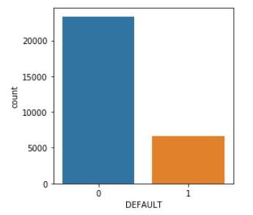
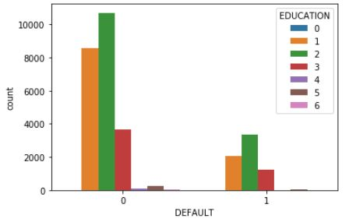
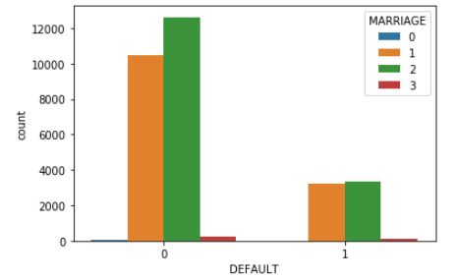
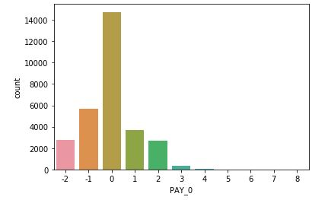
Flaws in the data:

Slide 7
Data cleaning
Assigned all ‘0’ in Marriage to ‘3’
Assigned all ‘0’ ‘5’ & ‘6’ in Education to ‘4’
Assigned ‘-2’ & ‘-1’ in Pay_0 - Pay_6 to ‘0’

Slide 8
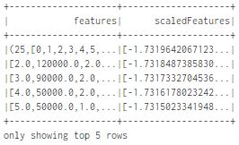
Feature scaling
Used a VectorAssembler to combine all the features into a single vector.
Then used a StandardScaler to features in the vector.

Slide 9

Model training
Divided the data into 80% and 20% for training and testing respectively.
Trained and tested three algorithms namely Logistic regression, Decision trees and Random Forest.
Initially trained the models on imbalanced data and then with the help of parameter tuning got the best models for Logistic regression and Random forest.
Used ROC as metric for evaluating the performance of the models.

Slide 10
Handling imbalanced classes
There are three ways we can handle imbalance in the data.
Up-sampling: Increase minority class by replicating them number of times in the dataset.
Down-sampling: Remove rows with majority class so that it matches with the count of minority class.
Assigning weights: Penalize majority class by assigning less weight and increase the value of minority class by assigning more weight.
I used assigning weights to deal the imbalance. Created a column which has 0.85 and 0.15 values.
0.85 is assigned to class ‘1’ and 0.15 is assigned to class ‘0’

Slide 11
Model training
Apply feature scaling
Split data for training and testing
Trained three models

Slide 12
Deploying project in cloud
Google Cloud Platform (GCP)
Created a new project.
Enabled two API’s namely Compute engine and Storage.
Upload project files to cloud storage.
Created a cluster using Dataproc API to run the project file.
Cluster has 1 master node and 2 worker nodes.
Submit project file as job in the cluster to get the results

Slide 13
Results
 | Before dealing with imbalanced classes | Best model with parameter tuning | After assigning weights to classes
Model | ROC | ROC | ROC
Logistic Regression | 0.5 | 0.761 | 1
Decision Tree | 0.266 | - | 1
Random Forest | 0.776 | 0.776 | 0.999

Slide 14
Conclusion
Imbalance in the classes will effect the performance of the models.
It is a good practice to deal with class imbalance before training models.

Slide 15
Questions?

